Slide 1
BIG DATA ANALYTICS
Dhrish S Kumar

Slide 2

Big Data Anlaytics

Slide 3
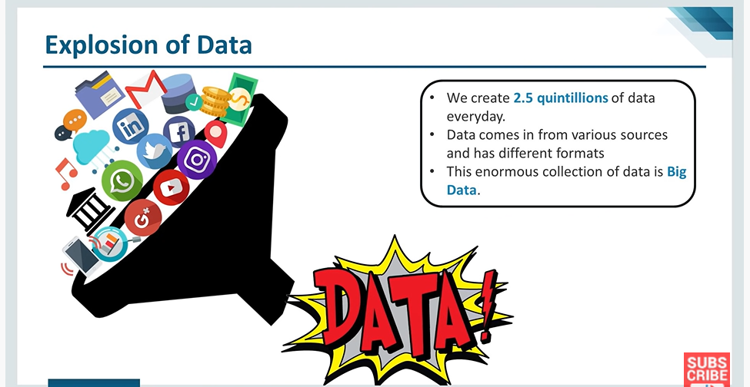
Why Big Data

Slide 4
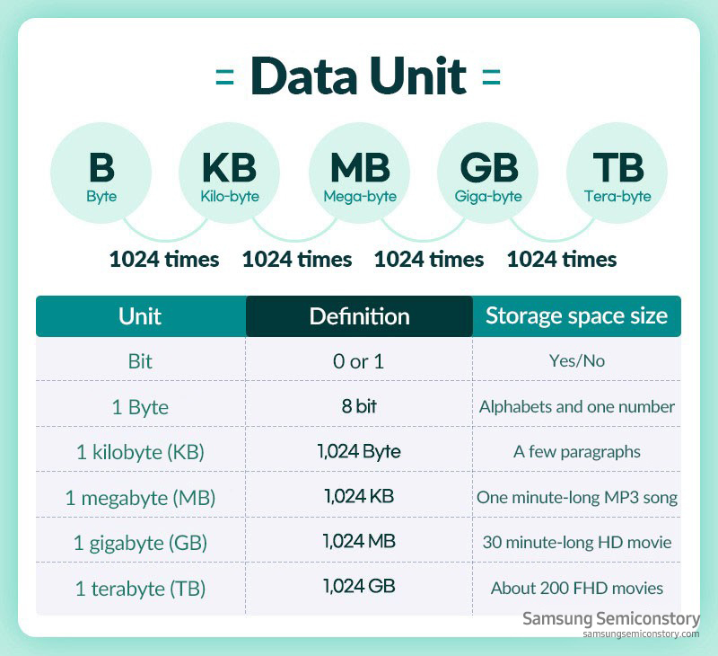

Slide 5
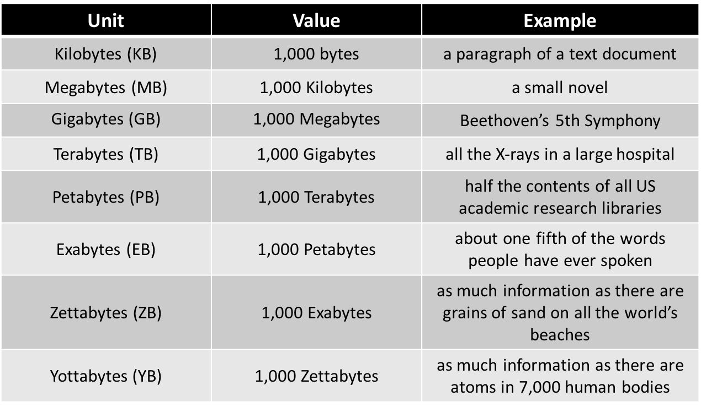

Slide 6
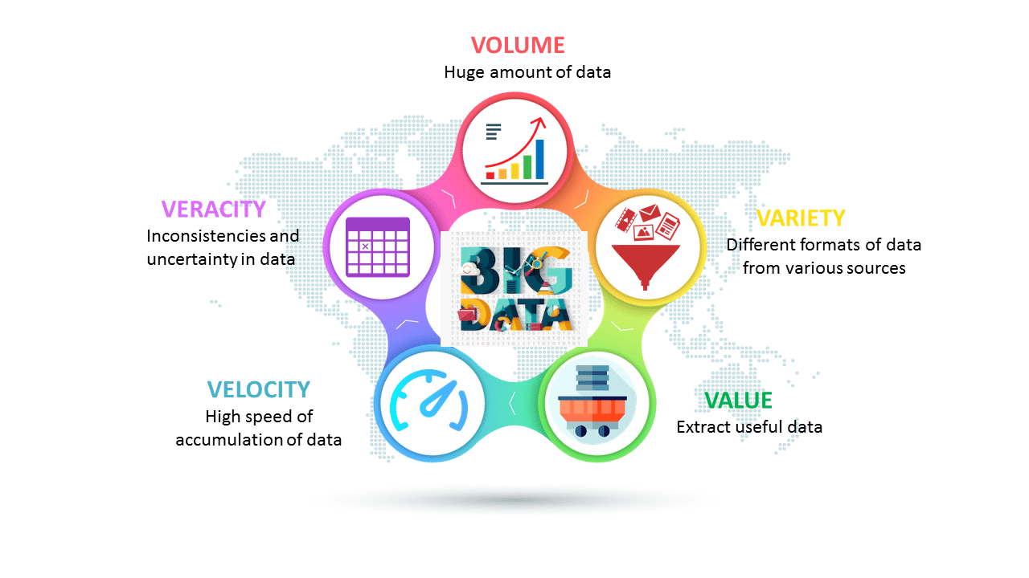
Characteristics of Big data
Structure
Semi-Structure
Unstructured

Slide 7
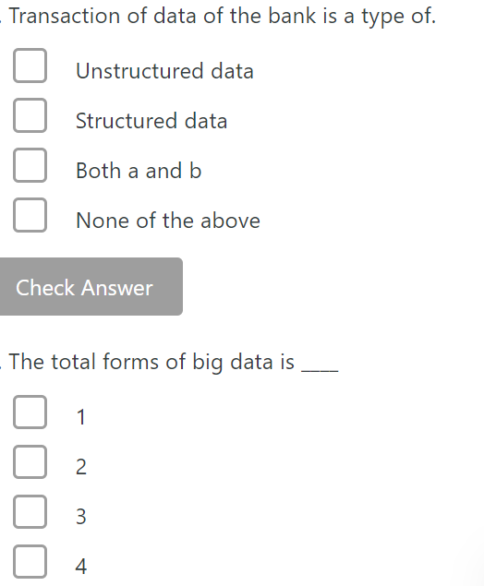
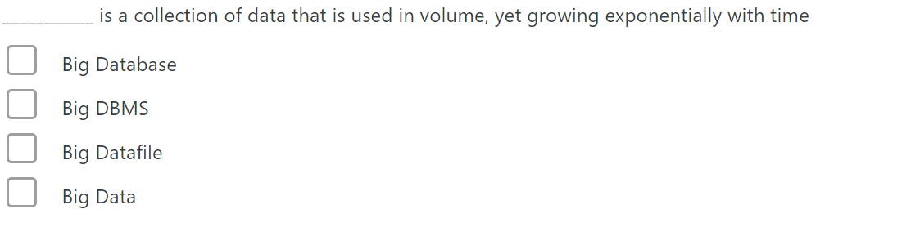
Data in ____ bytes size is called big data

Slide 8
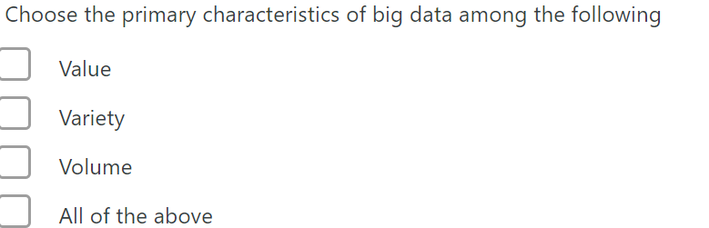
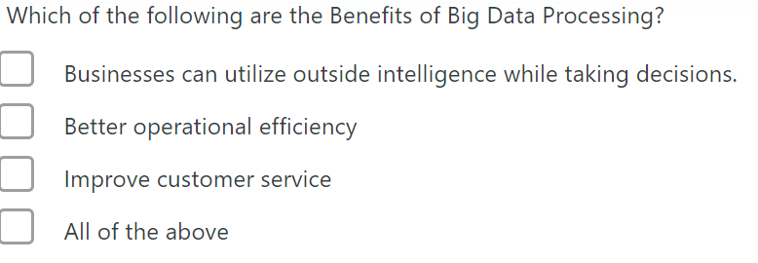
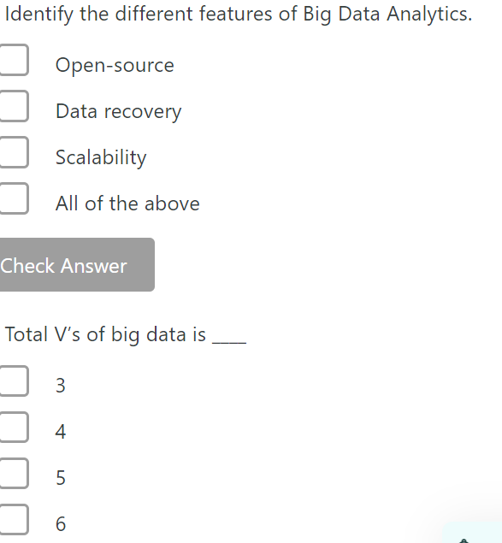
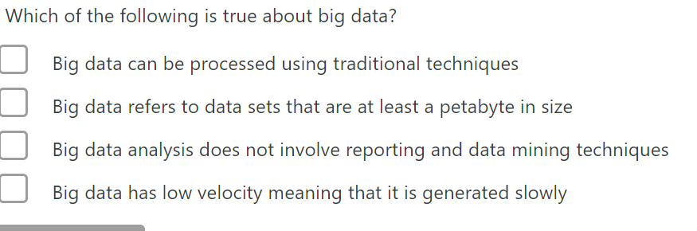
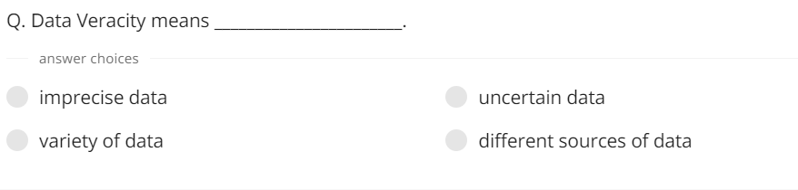

Slide 9


Slide 10


Slide 11


Slide 12
What is big data analytics
Big data analytics examines large and different types of data to uncover hidden patterns, correlations and other insights

Slide 13
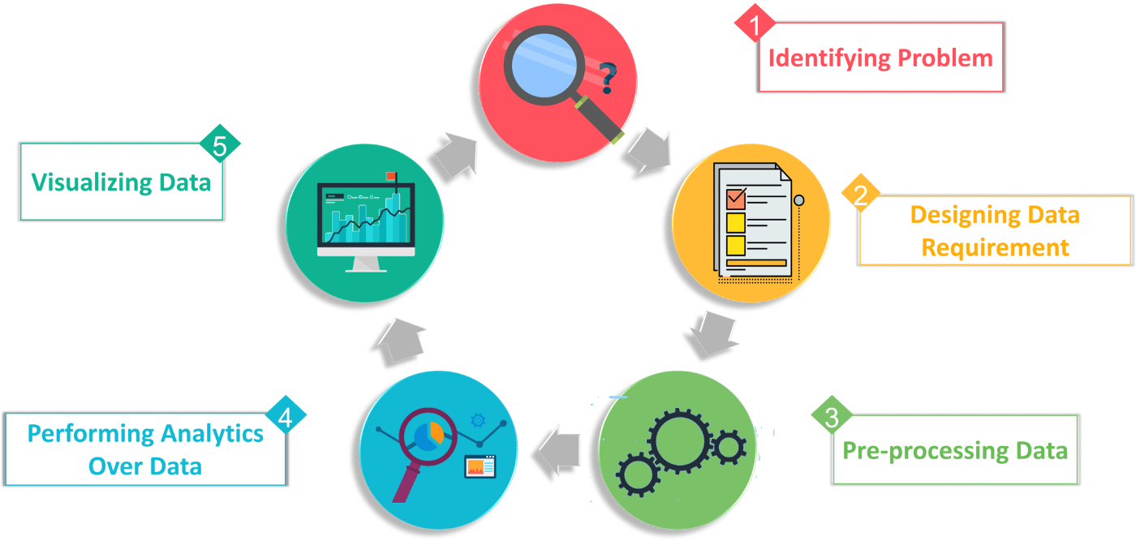
Stages of Big data analytics

Slide 14
Types of big data analytics
Descriptive analysis
Predictive analysis
Prescriptive analysis
Diagnostic Analysis

Slide 15
Descriptive analysis
What is happening now based on incoming data?
Google analytics tool is the best example for descriptive analysis. A business gets the result from the web server through the tool which helps understand what actually happened in the past and validate if a promotional campaign was successful or not based on basic parameters like page views.

Slide 16
Predictive analysis
What might happen in the future
For example, southwest airlines analysis sensor data on their planes in order to identify patterns that indicate a potential malfunction, thus allowing the airlines to the necessary repairs before schedule.

Slide 17
Prescriptive analysis
What action should be taken
Google’s self-driving car is an example of prescriptive analytics. It analyses the environment and decides the direction to take based on the data

Slide 18
Diagnostic Analytics
Why did it happen
For a social media marketing campaign, you can use diagnostic analytics to assess the number of posts, mentions, followers, fans, reviews, pins etc., and analyse the failure and success rate of the campaign at a fundamental level.

Slide 19
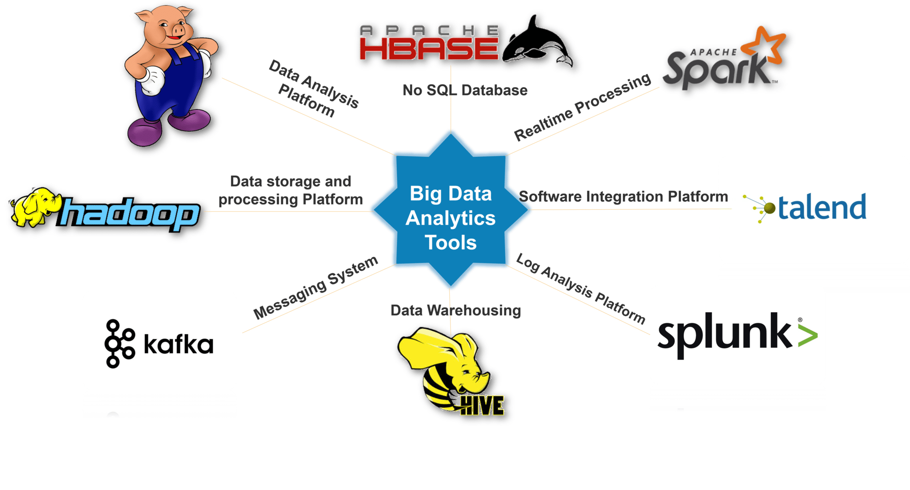
Tools used in Big Data Analytics

Slide 20
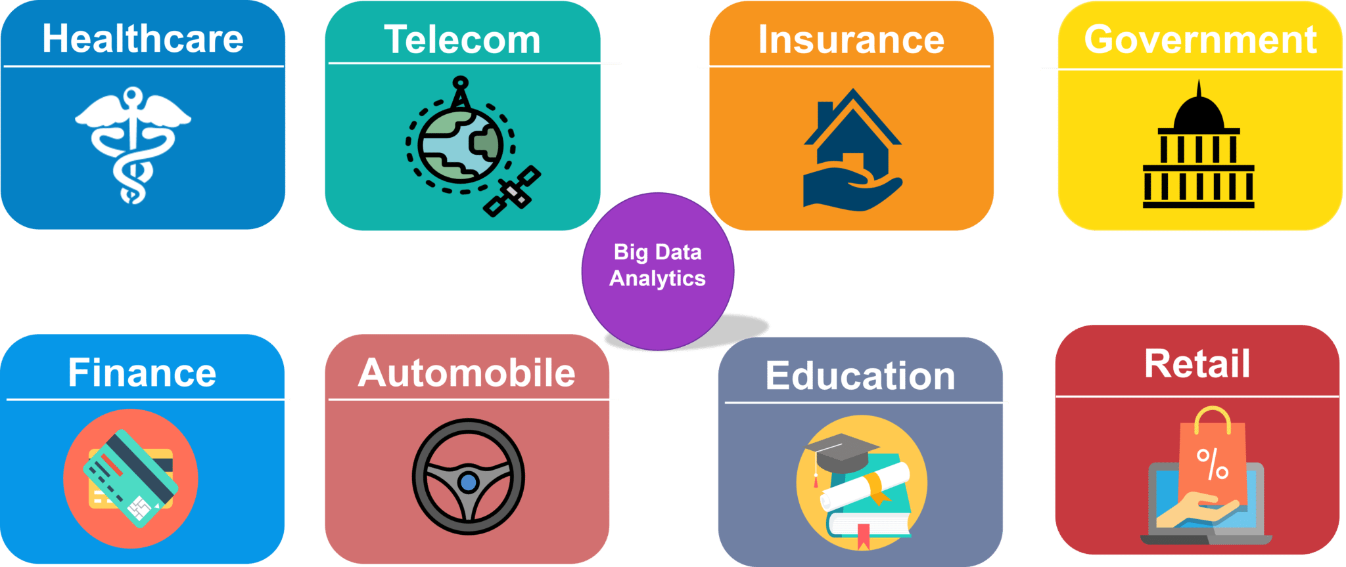
Domain using Big Data analytics

Slide 21
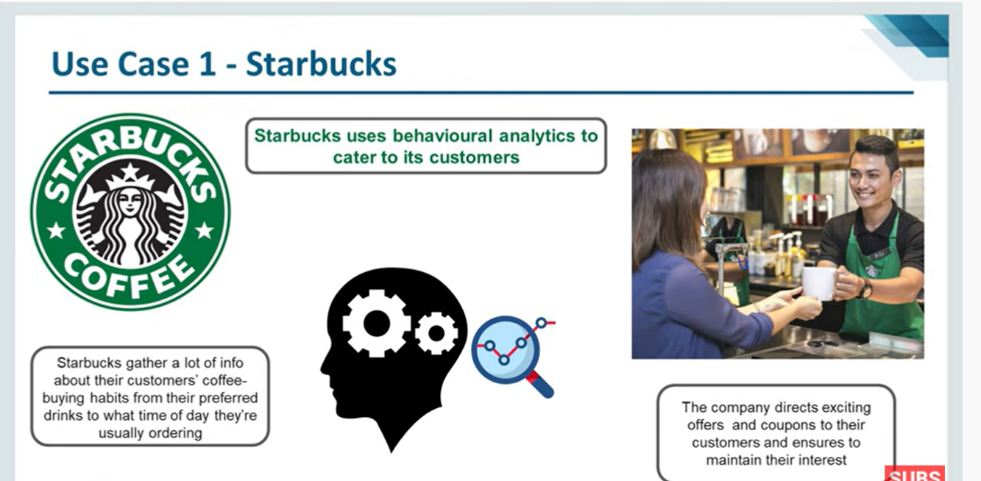

Slide 22


Slide 23


Slide 24
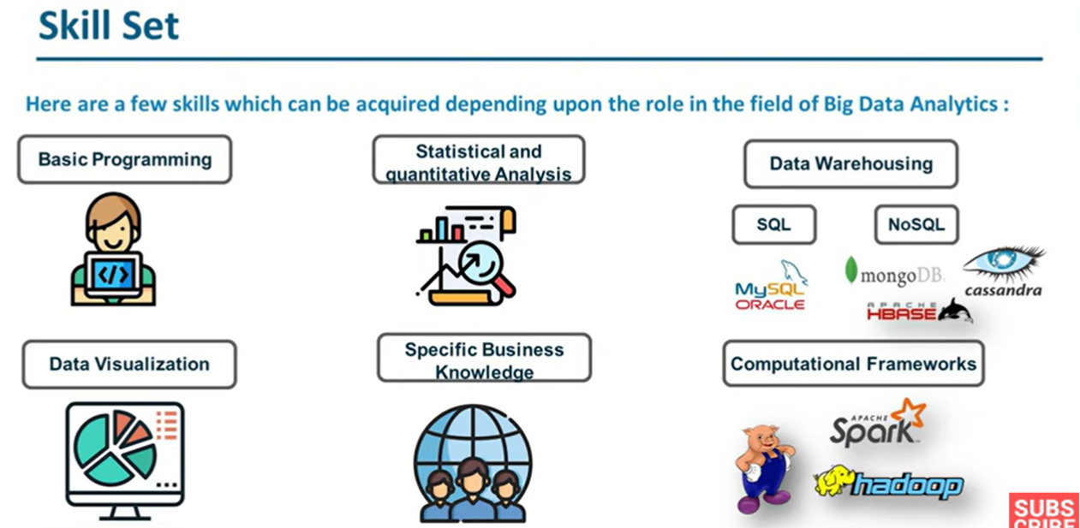

Slide 25
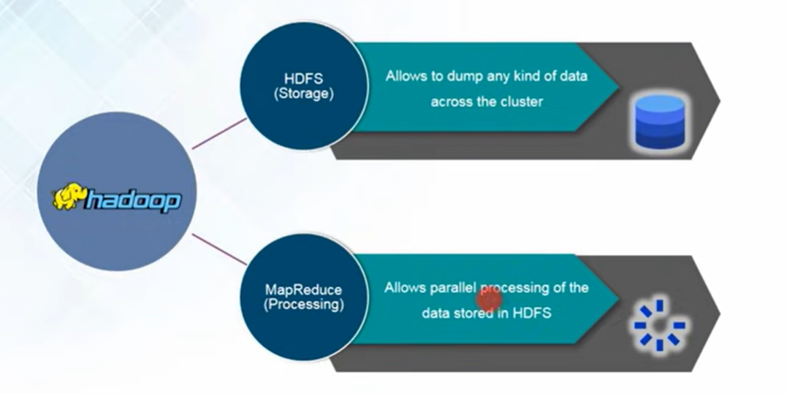
Hadoop
Hadoop is a framework that allows us to store and process large data sets in parallel and distributed fashion

Slide 26
DFS
A Distributed File System (DFS) as the name suggests, is a file system that is distributed on multiple file servers or multiple locations.
It allows programs to access or store isolated files as they do with the local ones, allowing programmers to access files from any network or computer

Slide 27
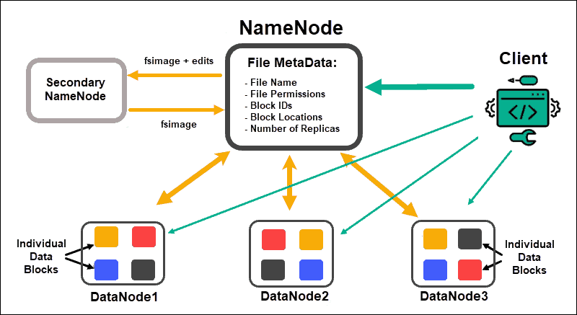
DFS has two components:
Location Transparency – Location Transparency achieves through the namespace component.
Redundancy – Redundancy is done through a file replication component.
In the case of failure and heavy load, these components together improve data availability by allowing the sharing of data in different locations to be logically grouped under one folder, which is known as the “DFS root”.

Slide 28
Features of DFS :
Transparency :
Structure transparency
Access Transparency
Naming transparency
Replication transparency
User mobility
Performance
Simplicity and ease of use
High availability
Scalability
High reliability
Data integrity
Security
Heterogeneity

Slide 29

Hadoop

Slide 30
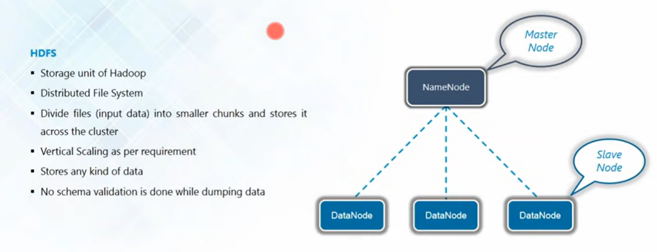
HDFS

Slide 31
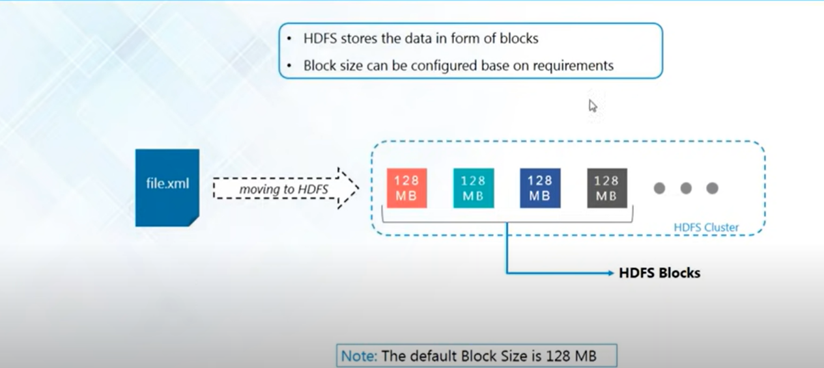
HDFS Block

Slide 32
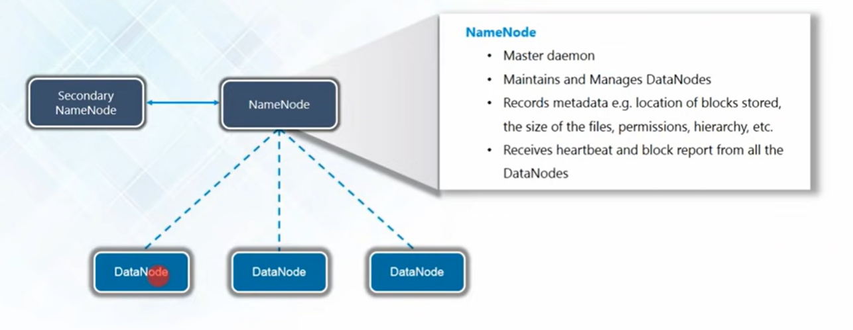
Name Node

Slide 33
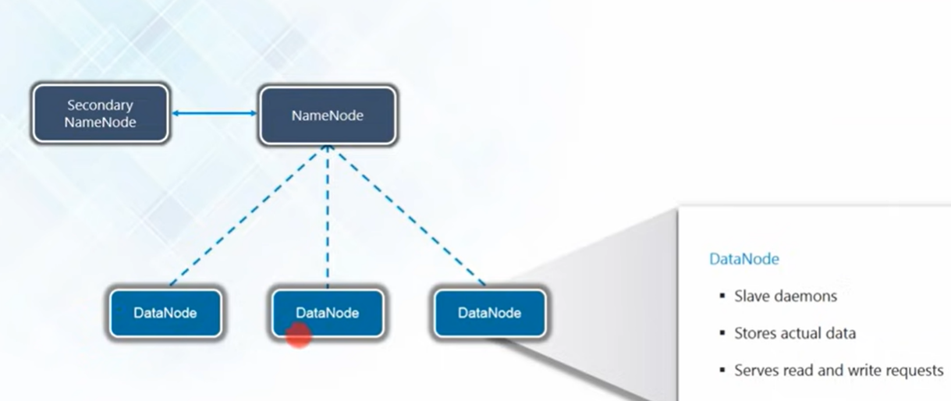
Data Node

Slide 34
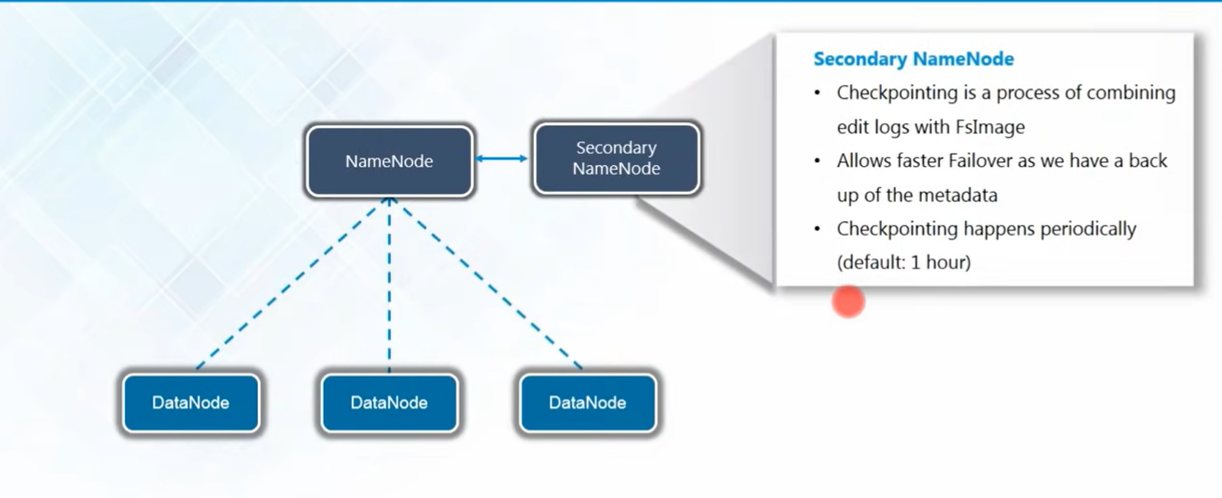
Secondary Name Node

Slide 35
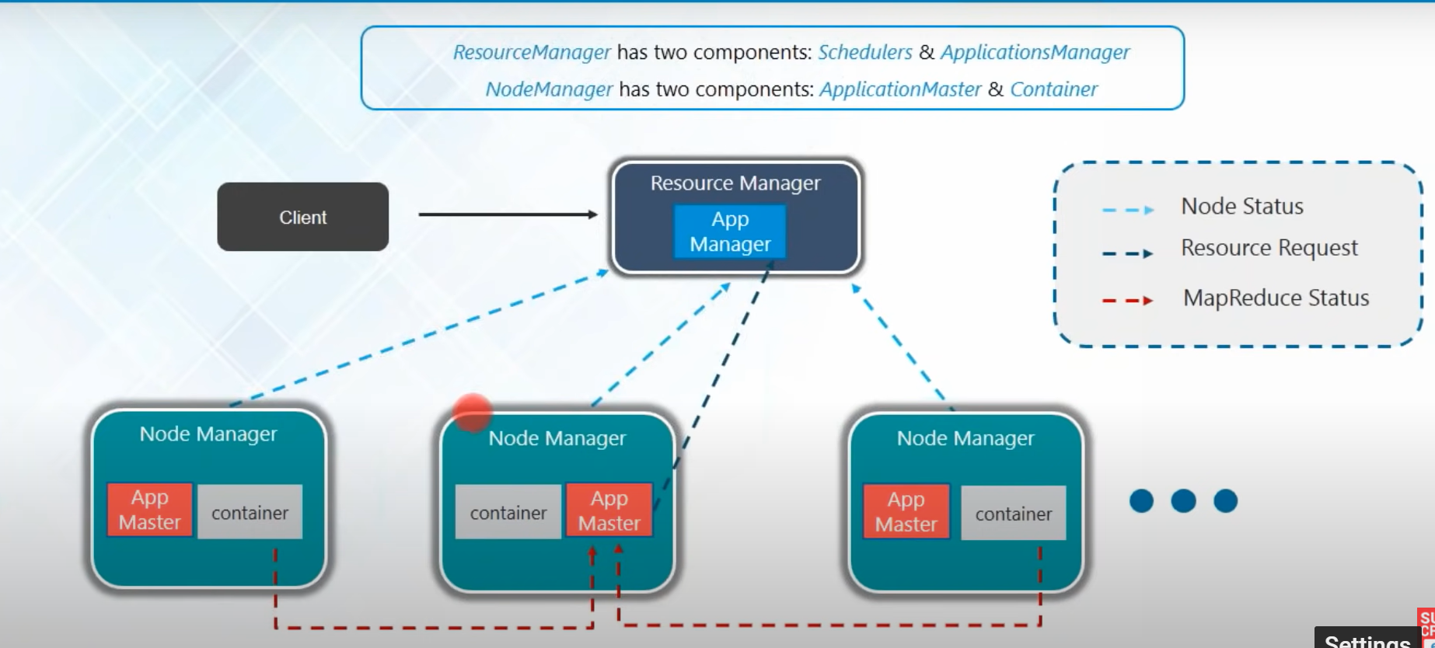
YARN Architecture

Slide 36
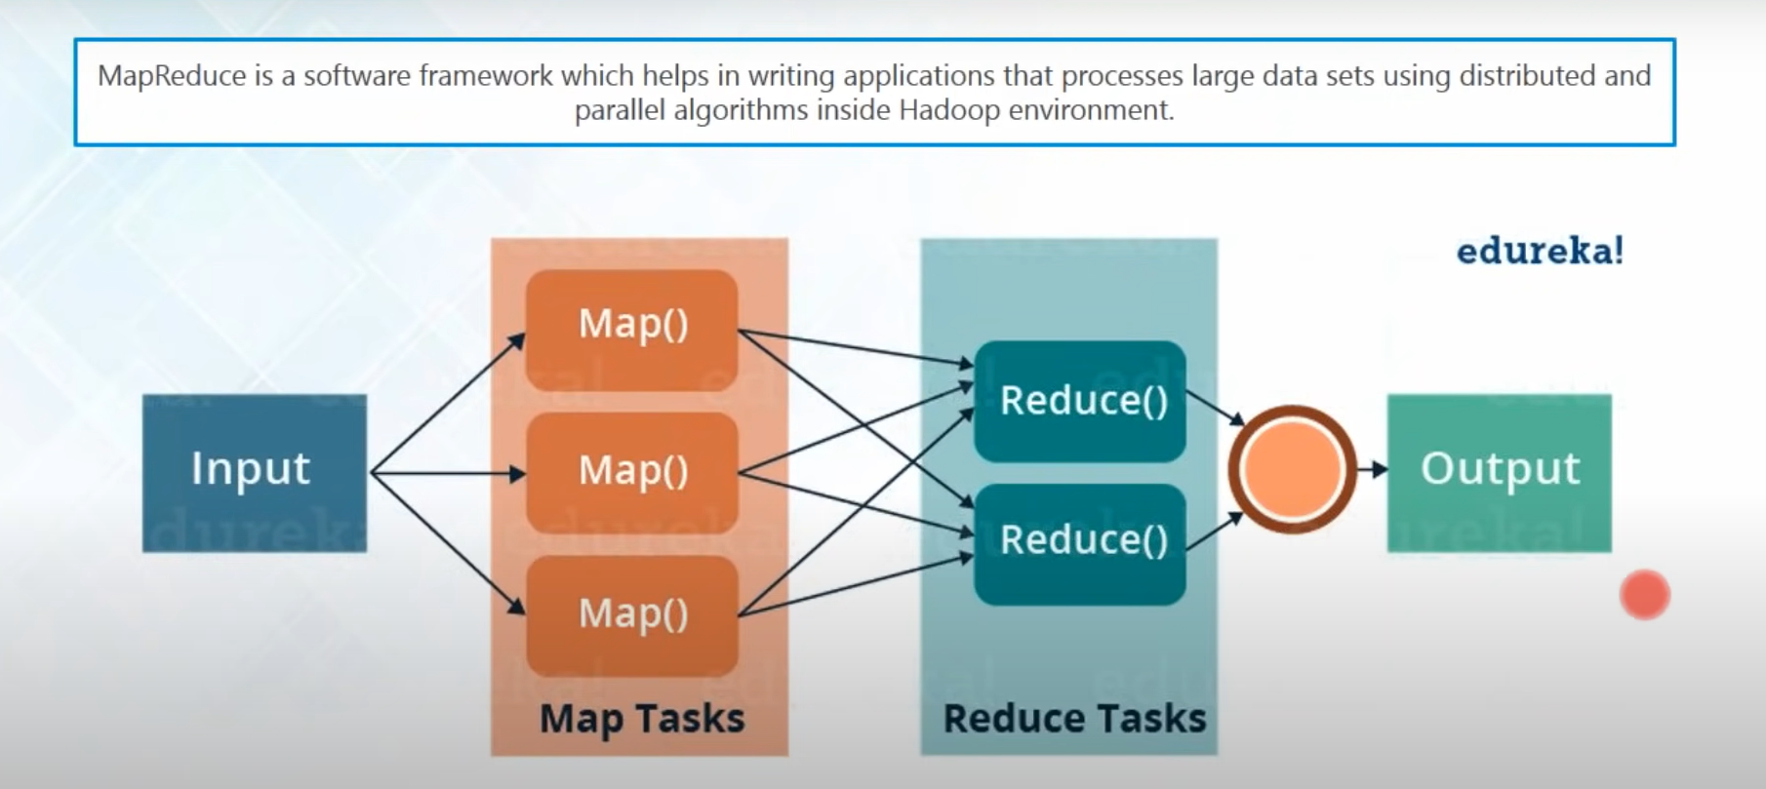
Map Reduce

Slide 37
How Does Namenode Handles Datanode Failure in Hadoop Distributed File System?
Hadoop file system is a master/slave file system in which Namenode works as the master and Datanode work as a slave
Namenode is so critical term to Hadoop file system because it acts as a central component of HDFS.
If Namenode gets down then the whole Hadoop cluster is inaccessible and considered dead.
Datanode stores actual data and works as instructed by Namenode. A Hadoop file system can have multiple data nodes but only one active Namenode.

Slide 38
Basic operations of Namenode:
Namenode maintains and manages the Data Nodes and assigns the task to them.
Namenodde does not contain actual data of files.
Namenode stores metadata of actual data like Filename, path, number of data blocks, block IDs, block location, number of replicas and other slave related informations.
Namenode manages all the request(read, write) of client for actual data file.
Namenode executes file system name space operations like opening/closing files, renaming files and directories.

Slide 39
Basic Operations of Datanode
Datanodes is responsible of storing actual data.
Upon instruction from Namenode, it performs operations like creation/replication/deletion of data blocks.
When one of Datanode gets down then it will not make any effect on Hadoop cluster due to replication.
All Datanodes are synchronized in the Hadoop cluster in a way that they can communicate with each other for various operations.

Slide 40
What happens if one of the Datanodes gets failed in HDFS?
Namenode periodically receives a heartbeat and a Block report from each Datanode in the cluster. Every Datanode sends heartbeat message after every 3 seconds to Namenode. The health report is just information about a particular Datanode that is working properly or not. In the other words we can say that particular Datanode is alive or not.

Slide 41
A block report of a particular Datanode contains information about all the blocks on that resides on the corresponding Datanode. When Namenode doesn’t receive any heartbeat message for 10 minutes(ByDefault) from a particular Datanode then corresponding Datanode is considered Dead or failed by Namenode. Since blocks will be under replicated, the system starts the replication process from one Datanode to another by taking all block information from the Block report of corresponding Datanode. The Data for replication transfers directly from one Datanode to another without data passing through Namenode.

